Slide 1

Estimate the signal in the presence of noise –

Slide 2
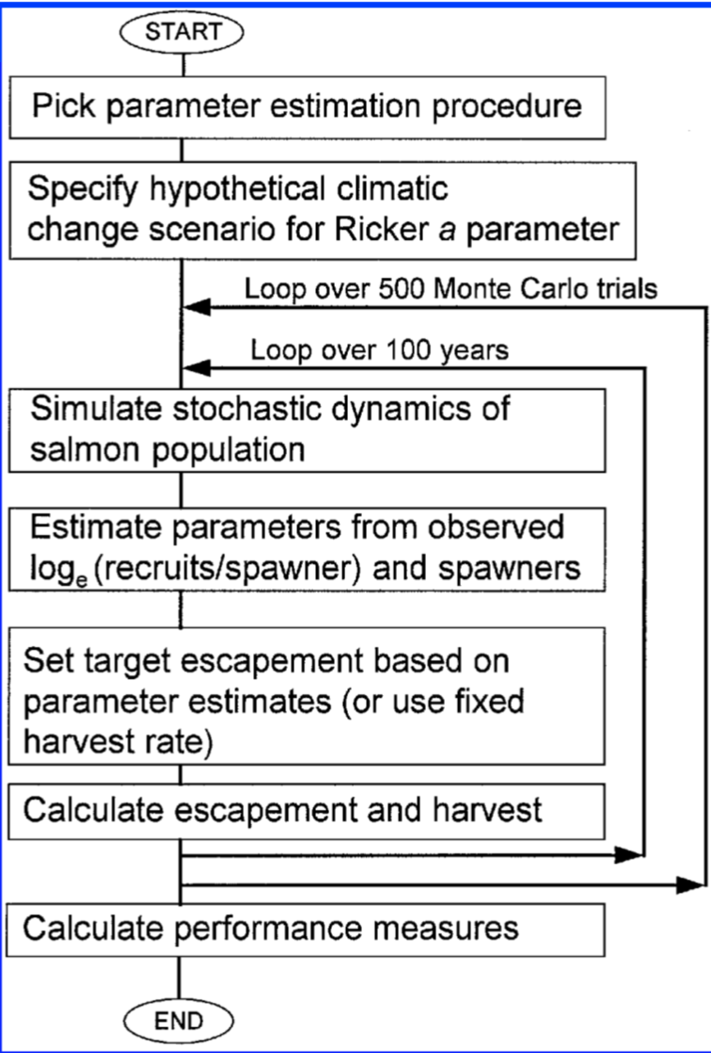

Stock-recruitment relationship
standard linear regression
Walters’ (1990) bias-corrected linear regression
Kalman filter.

Slide 3
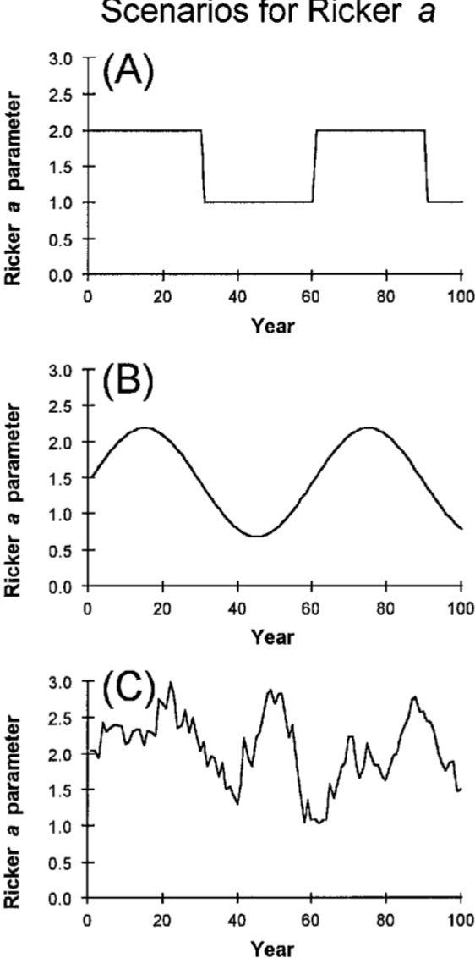
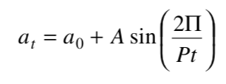


abrupt increases or de- creases (Fig. 2A) in productivity that persisted for a specified num- ber of years
sine wave in Ricker a (Fig. 2B) to simulate cyclical, but more gradual, decadal-scale variations in productivity
stochastic process using a first-order autoregressive (AR(1)) model

Slide 4
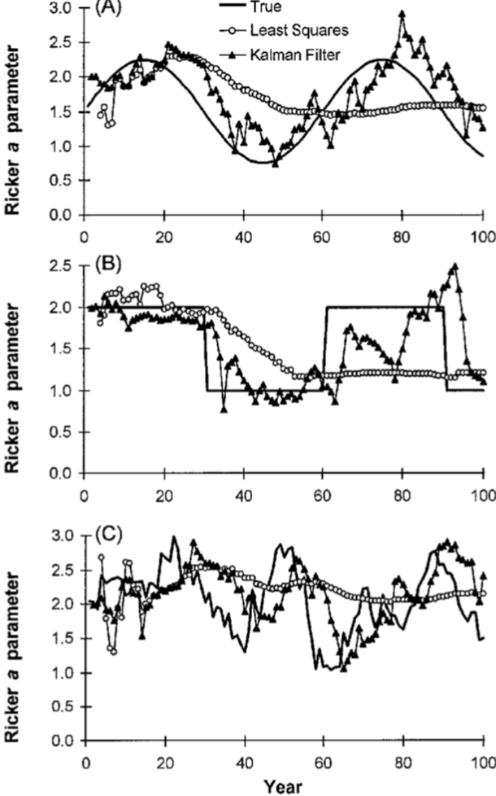
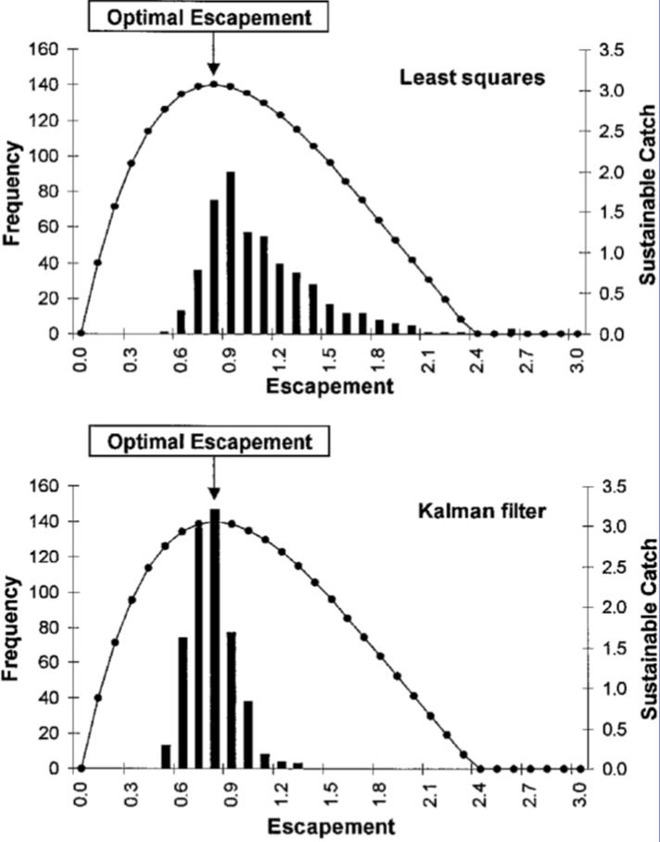
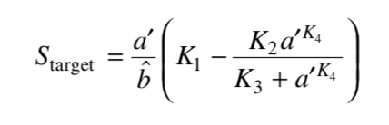
parameter estimates were then used to set the target escapement and hence harvest strategy in year t.

Slide 5
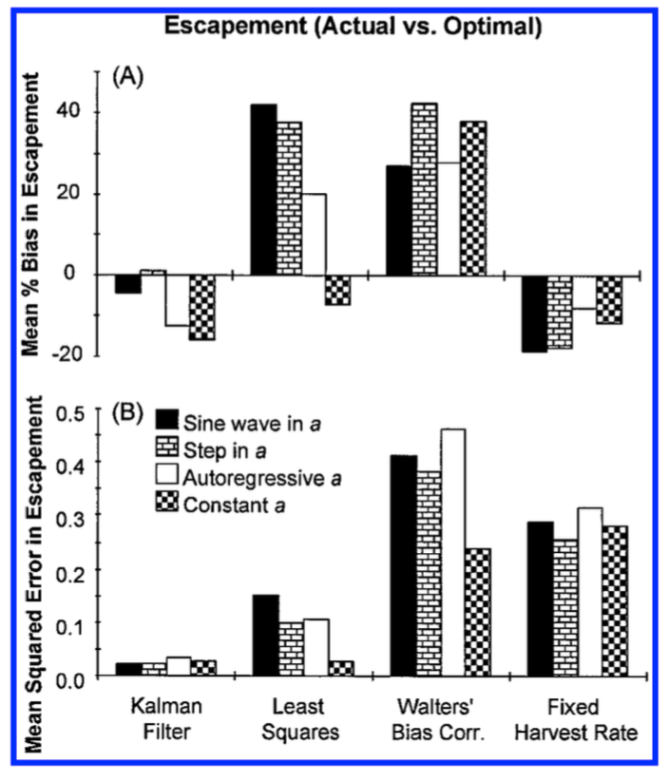
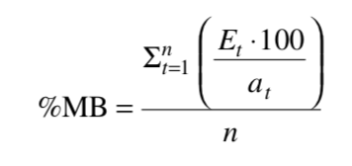
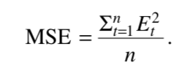
Mean percent bias
Mean squared error

